Slide 1




IBM HR Data Analysis
by Team ROMA

Slide 2


Agenda:
Who Are We?
Understanding the Data
Data Cleaning Process
Dashboards & Key Insights
Conclusion

Slide 3
Who are we ?
Team ROMA:
R for Raslan, O for Omar, M for Mohammed, A for Ahmed

Slide 4




Who are we ?
Omar Yasser
Ahmed Alaa
Python Insights Creator and Data Cleaning Expert
Python Insights Creator and Data Cleaning Specialist
Mahmoud Raslan
Mohammed Sameh
Dashboard Expert, Report Specialist, and Presentation Creator
Dashboard Expert, Blueprint Architect and Storytelling Specialist

Slide 5

What is the Data?
Dataset Overview:
IBM HR dataset with key columns such as:
Age, Attrition, Job Role, Education Level
Job Satisfaction, Work-Life Balance, and more
Provides comprehensive employee data for analysis
Purpose of the Analysis:
To explore insights related to:
Employee satisfaction, attrition rates, performance
Demographic distributions and workforce trends

Slide 6

Data Cleaning Process
If you want to see the full cleaning file, click here.

Slide 7

1) Data Cleaning

Slide 8
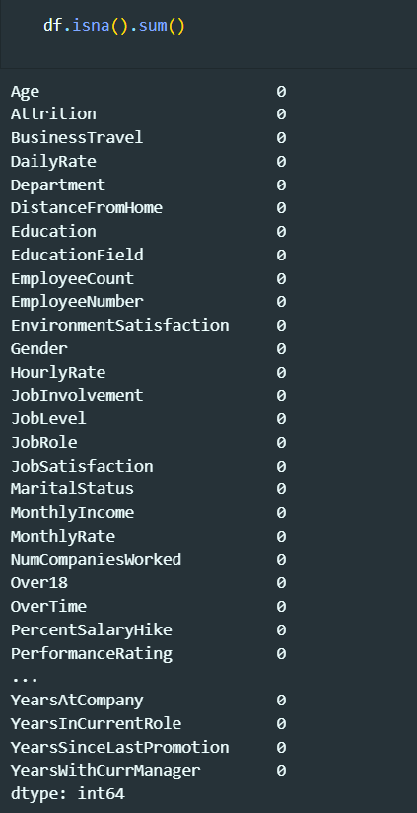
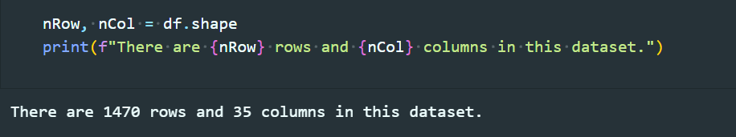
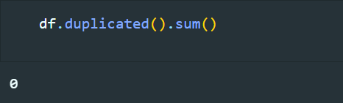
Overview of the Data

Slide 9
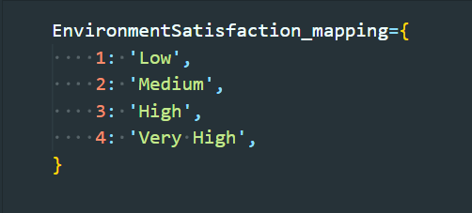
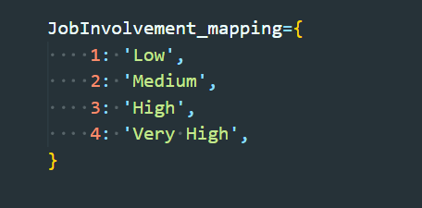
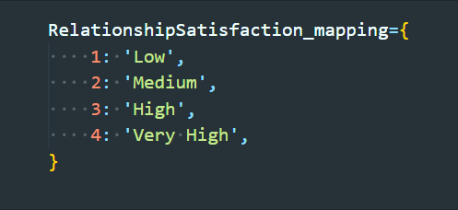
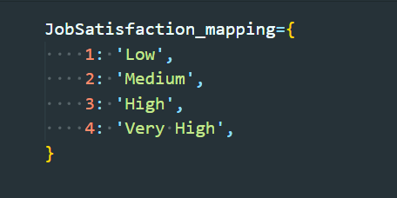
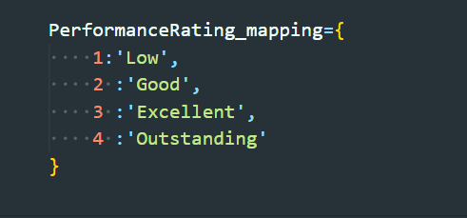
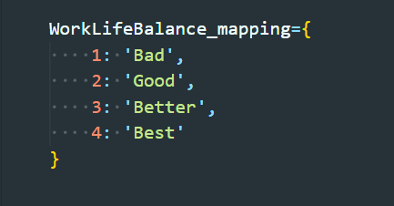
Mapping Numeric Values

Slide 10
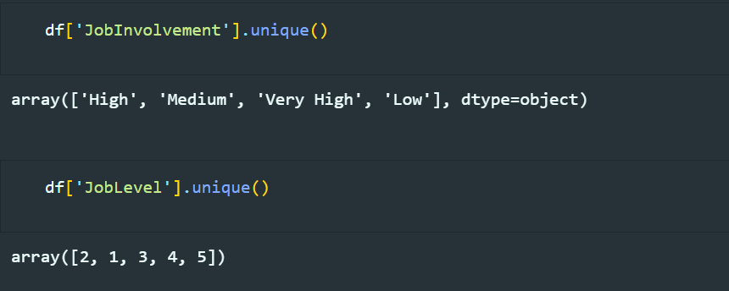
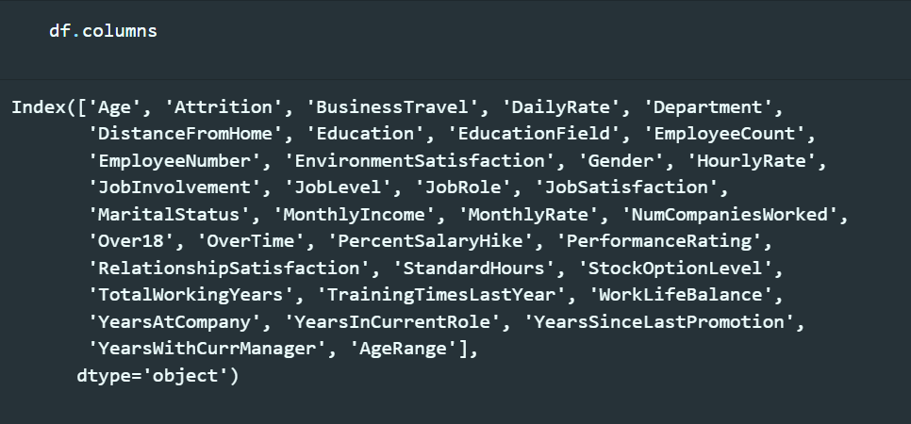


Exploring Data Attributes

Slide 11

2) Charts by Python (cleaning):

Slide 12
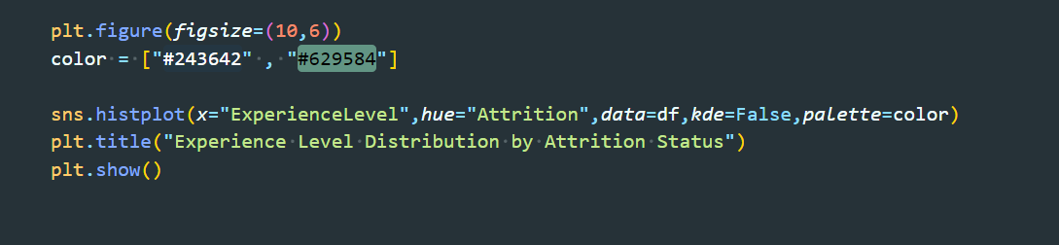
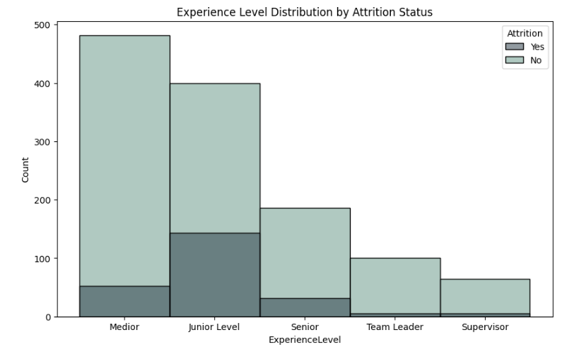
The slide displays a histogram of Experience Level with hues Representing Attrition Status (Yes/No).

Slide 13
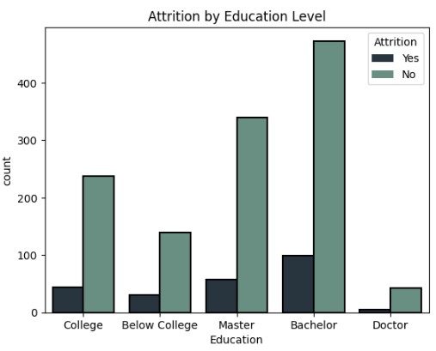
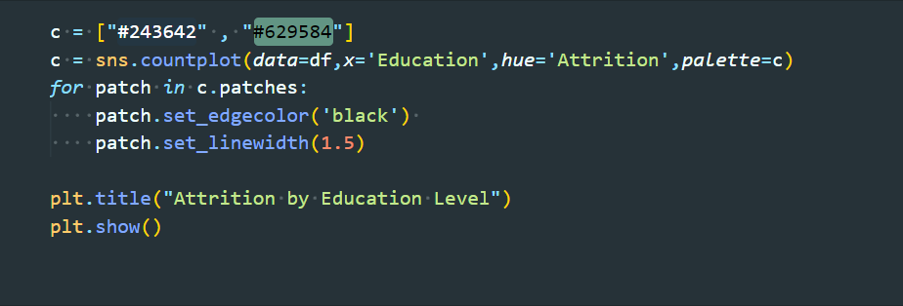
This slide provides a visual representation of the relationship between Attrition (employee turnover) and Education Level within the company.

Slide 14
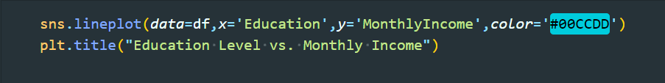
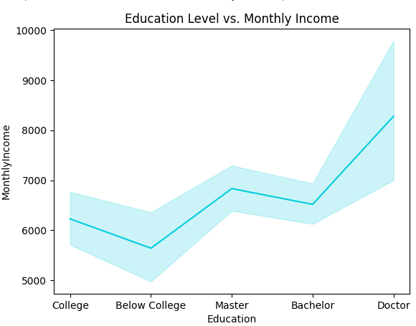
The chart displays the relationship between education levels and monthly income. It visualizes how income varies across different education levels, with a line plot.

Slide 15
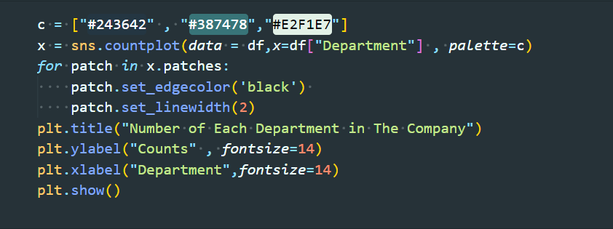
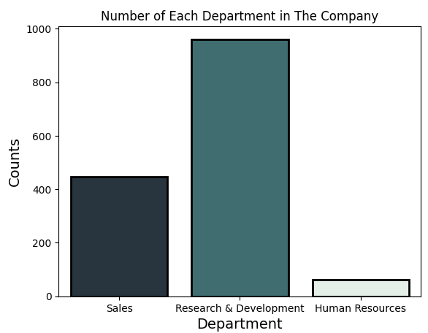
This slide presents the distribution of employees across three departments in the company: Sales, Research & Development, and Human Resources. The bar chart shows that most employees belong to the Research & Development department, followed by Sales, with the fewest in Human Resources.

Slide 16
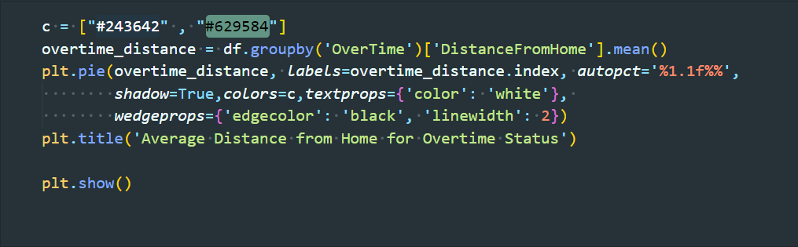
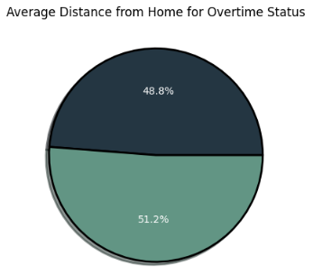
It visualizes the proportion of average distance employees live from home based on them overtime status.
48.8% represents one category (likely employees
who do not work overtime).
51.2% represents the other category (likely employees who do work overtime).

Slide 17
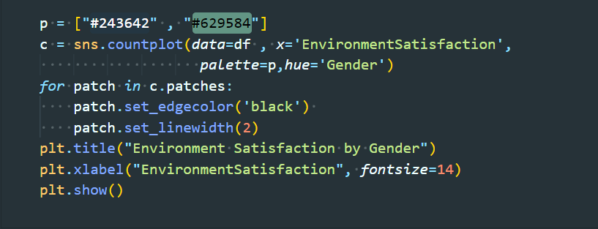
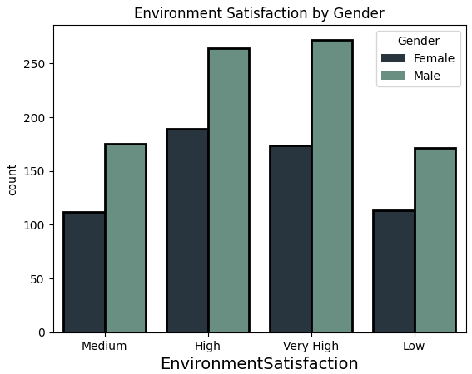
The chart compares the environment satisfaction levels of male and female employees. The chart shows that female employees have higher levels of satisfaction than male employees, particularly in the "Very High" category.

Slide 18
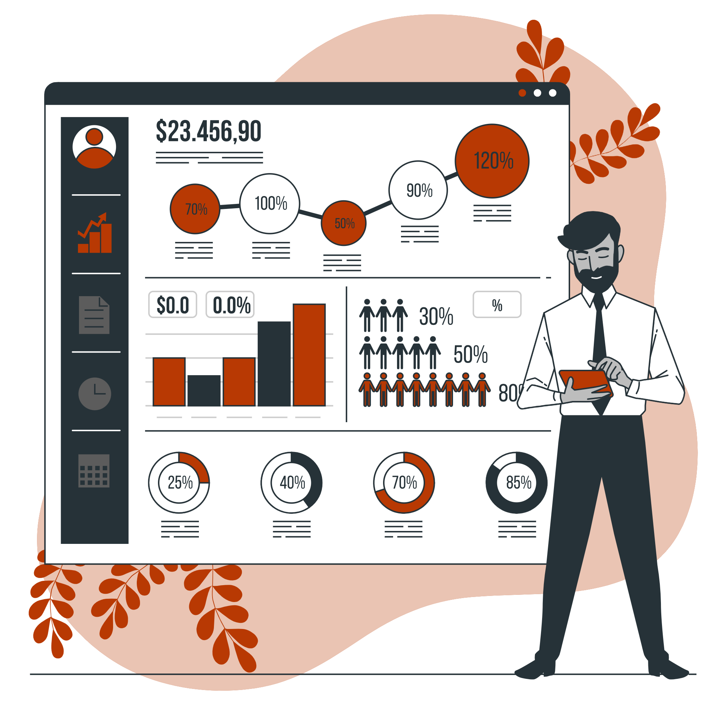
Dashboards & Insights
If you want to see the full Dashboards in Tableau, click here.

Slide 19
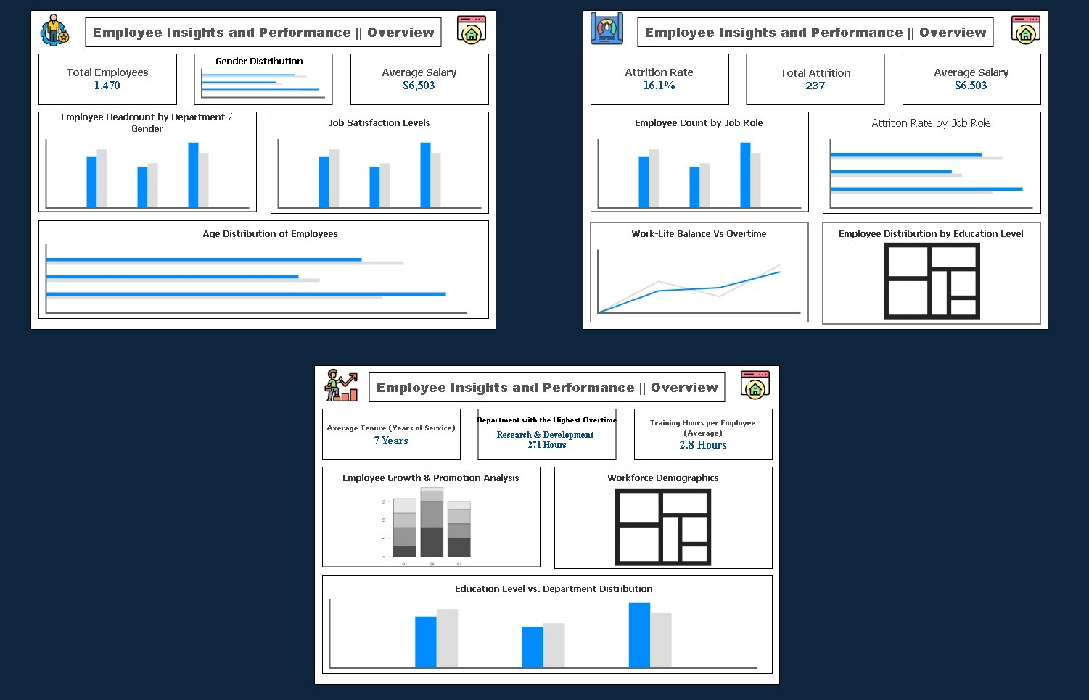
Employee Insights and Performance Blueprint
Summary:
This blueprint highlights key metrics such as employee headcount, salary, attrition, job satisfaction, and workforce demographics. It covers gender, age, education, overtime, tenure, and training hours, offering a concise view of employee performance for informed HR decisions.

Slide 20

HR Dashboard Homepage
Summary :
The IBM HR Dashboards homepage provides a visually appealing overview of HR analytics. The three main sections—Employee Insights and Performance, Attrition Analysis, and Development Metrics—offer comprehensive insights into employee data. Interactive icons allow users to easily navigate between these sections, making it a user-friendly tool for HR professionals.

Slide 21
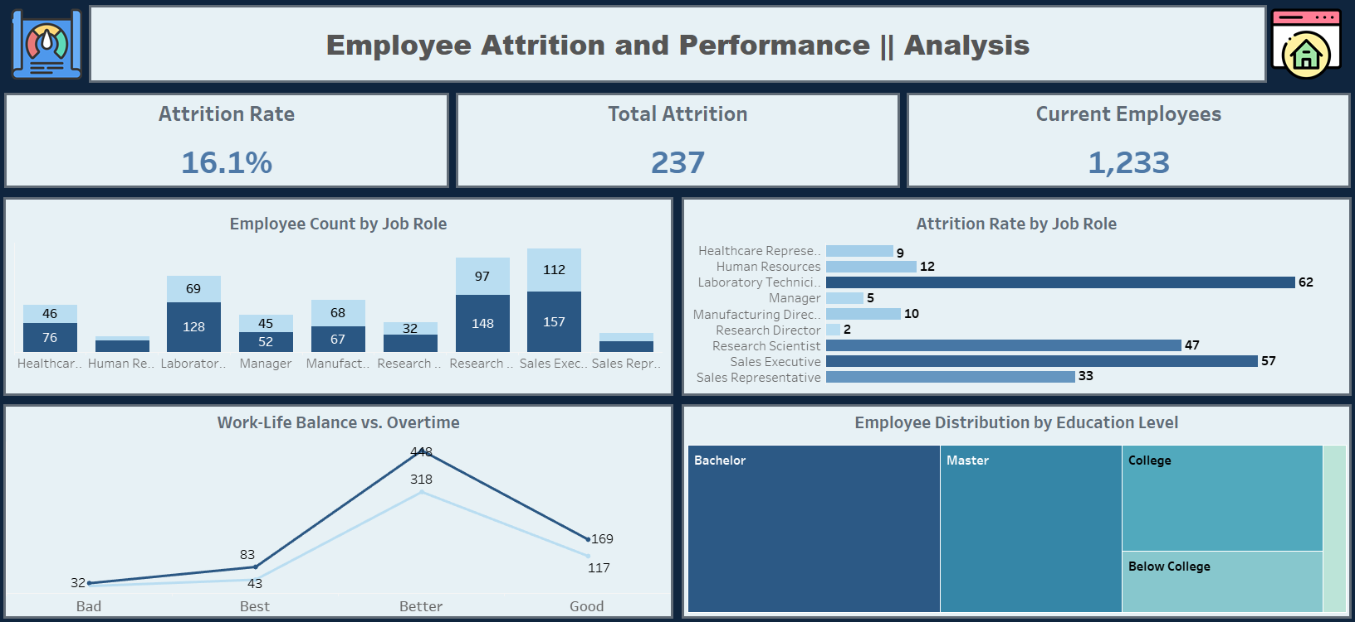

Slide 22
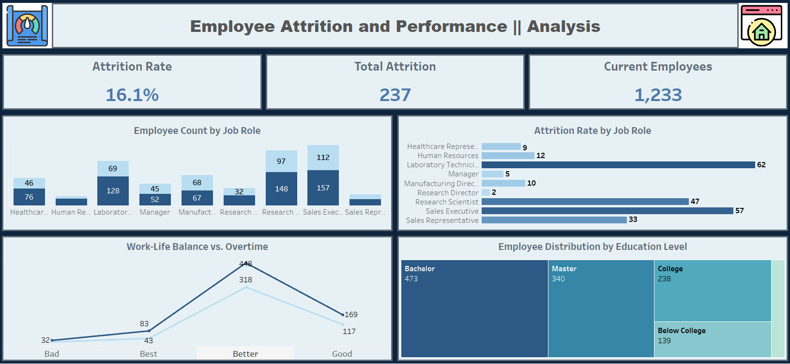
Attrition Overview
Content Overview:
Attrition Rate (Card): Displays the percentage of employees who left.
Total Attrition (Card): Shows the total number of employees who have exited.
Current Employees (Card): Provides the total count of active employees.

Slide 23

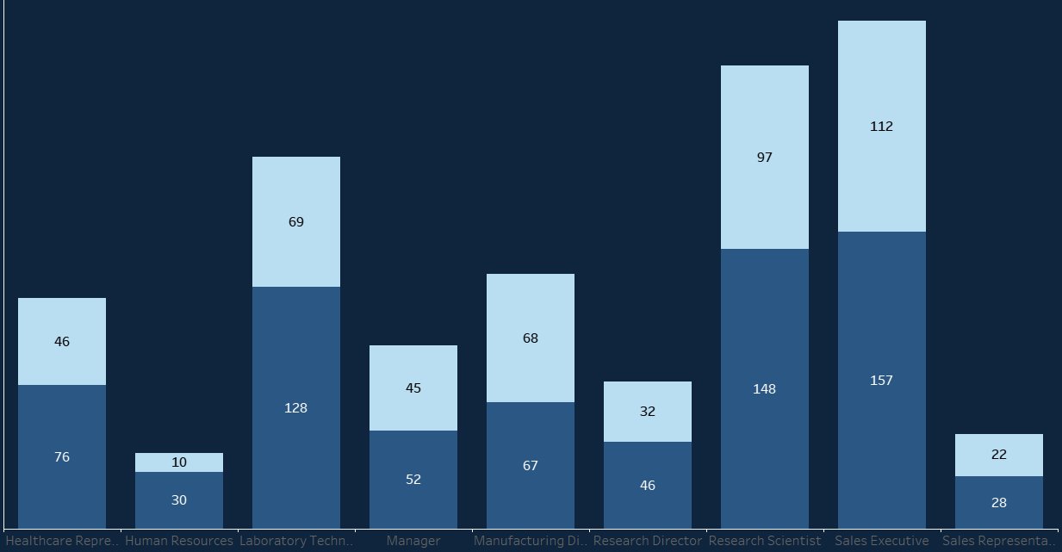
Employee Count by Job Role / Gender
Chart Type: Stacked Column Chart
Insight :
This chart showcases the distribution of employees by job role and gender. It highlights the diversity within job roles and can indicate whether certain roles are dominated by one gender, which might affect attrition trends or job satisfaction.

Slide 24
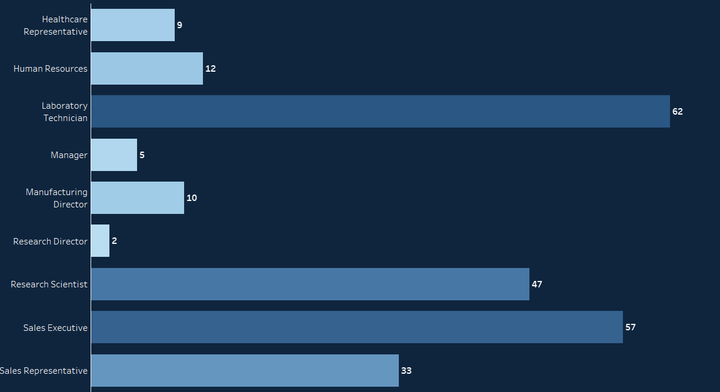
Attrition Rate by Job Role
Chart Type : Bar Chart
Insight :
This chart reveals which job roles have the highest attrition rates. Roles with high attrition may need further investigation to address potential issues such as job satisfaction, workload, or opportunities for growth.

Slide 25
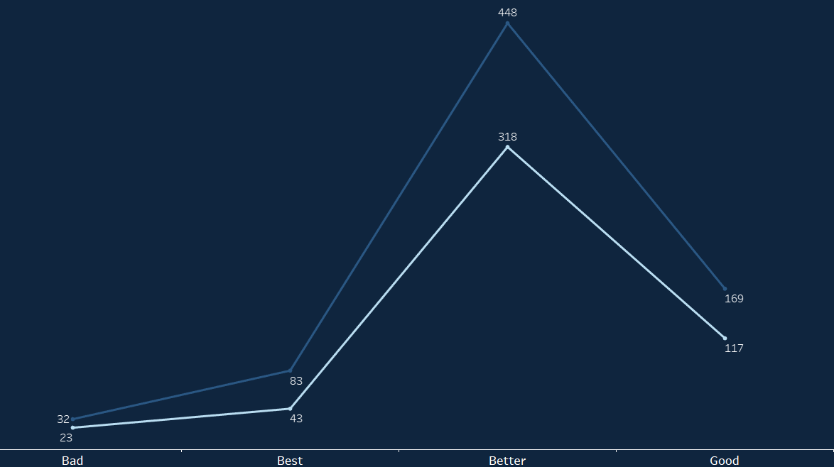
Work-Life Balance vs. Overtime by Gender
Chart Type : Line Chart (with separate lines for male and female employees)
Insight :
This chart compares work-life balance with overtime across genders. It can help identify if employees working more overtime report lower work-life balance, which could contribute to attrition, especially if one gender is more affected.

Slide 26
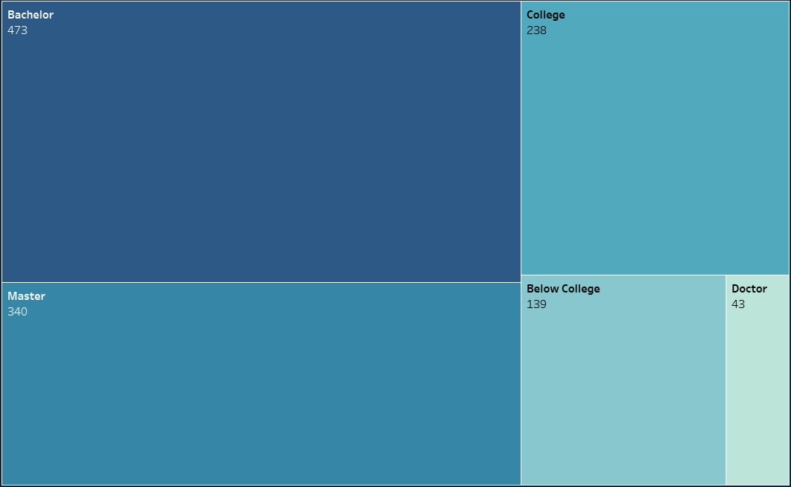
Employee Distribution by Education Level
Chart Type : Tree Map
Insight :
The distribution of employees by education level shows which educational qualifications are most prevalent. This can highlight whether employees with certain education levels are more likely to leave or stay, and whether the company is attracting employees with the desired qualifications.

Slide 27
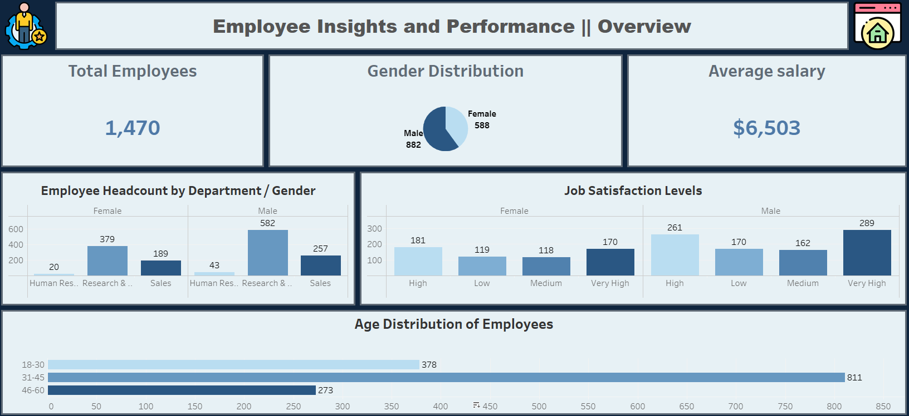

Slide 28
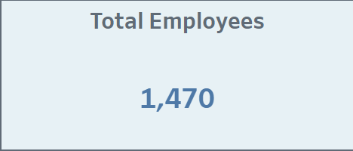

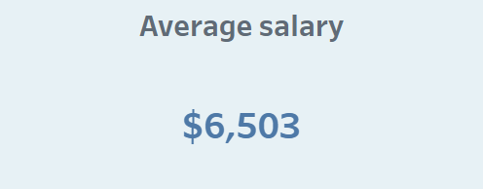
Employee Overview
Content Overview:
Total Employee (Card): Displays the total number of employees working in the company.
Gender Distribution (Card): Shows the total number of males and females in the company.
Average Salary (Card): Displays the typical employee salary within the organization.

Slide 29
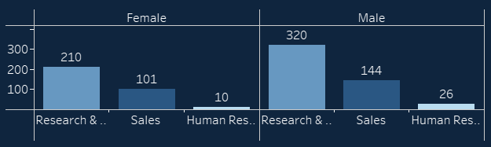
Employee Headcount by Department / Gender
Chart Type : Clustered Bar Chart
Insight :
Research & Development is the largest department, followed by Sales. There's a gender imbalance in Sales, with more male employees. Human Resources has a more balanced gender distribution.

Slide 30
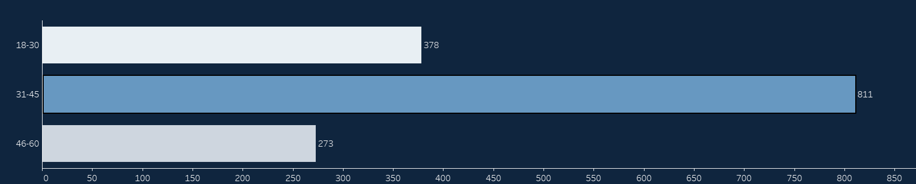
Age Distribution of Employees
Chart Type : Horizontal Bar Chart
Insight :
The chart shows the age distribution of employees. The 31-45 age group has the highest number of employees, followed by the 18-30 age group. The 46-60 age group has the smallest number of employees. This suggests that the majority of the workforce is relatively young, with a significant concentration in the 31-45 age range.

Slide 31
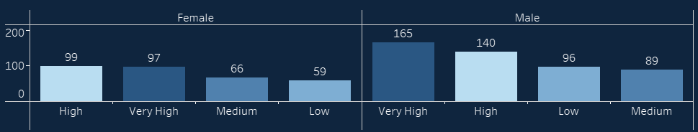
Job Satisfaction Levels
Chart Type : Clustered Bar Chart
Insight :
More female employees report high job satisfaction compared to male employees. However, a higher percentage of male employees rate their satisfaction as very high. Among females, the highest satisfaction is for "Very High," while among males, "High" and "Very High" are the most common ratings.

Slide 32
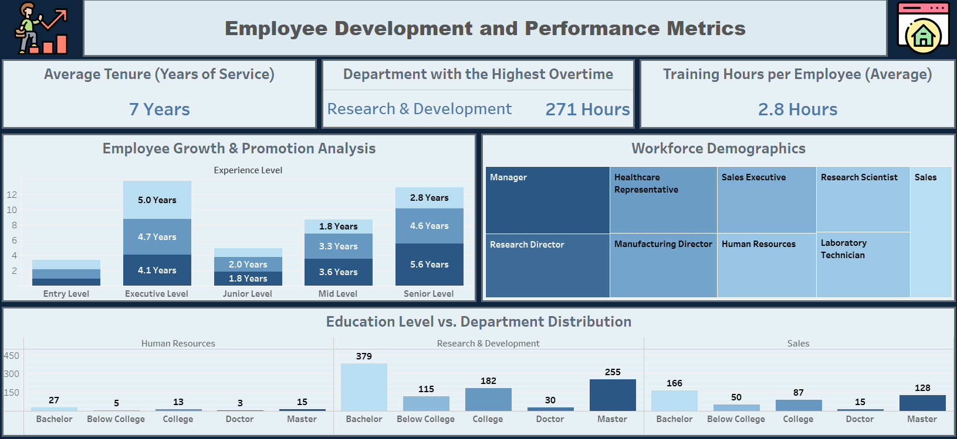

Slide 33
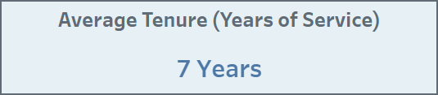
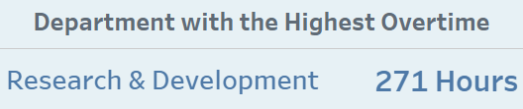
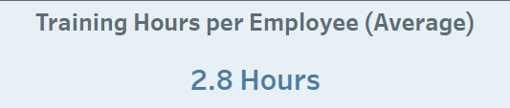
Attrition Overview
Content Overview:
Average Tenure (Card): Displays the average years of Service for the employees working in the company.
Department with the Highest Overtime (Card): Research & Development has the most overtime: 271 hours between all departments.
Average Training Hours per Employee (Card): Displays The average training hours per employee is 2.8 hours.

Slide 34
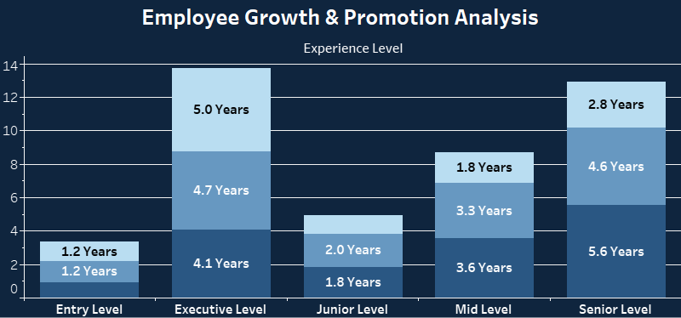
Employee Growth & Promotion analysis
Chart Type : Stacked Bar Chart
Insight :
The chart shows the average years of experience for employees at different levels. Executive Level has the highest average experience (5.0 years), followed by Senior Level (4.7 years). Entry Level has the lowest average experience (1.2 years). This indicates a clear progression in experience levels as employees advance in their careers.

Slide 35
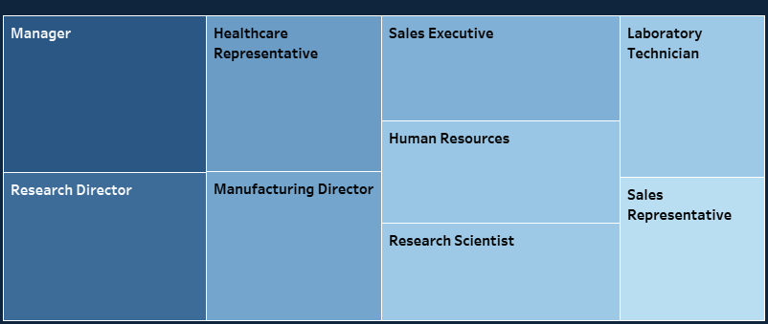
Workforce Demographics
Chart Type : Tree Map
Insight :
The chart shows the organizational structure of the company, with the Manager at the top. There are distinct departments such as Research & Development, Sales, and Human Resources, with various roles within each department. The chart provides insight into reporting relationships and potential areas for organizational development.

Slide 36
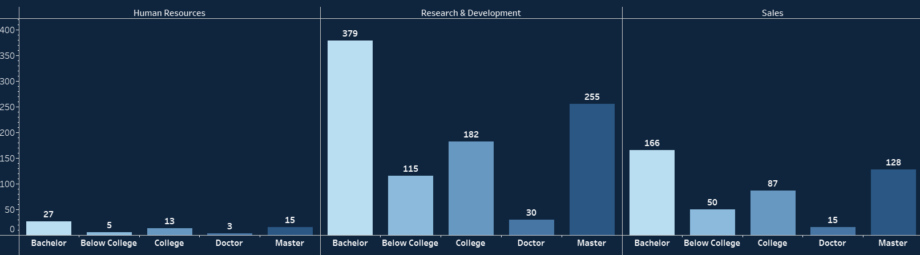
Education Level vs. Department Distribution
Chart Type : Grouped Bar Chart
Insight :
Research & Development has the most employees with a Bachelor's degree, followed by Sales. Human Resources has fewer employees, mostly with Bachelor's degrees. This shows different departments favor different educational backgrounds.

Slide 37

Summary
Cleaned and prepared the HR dataset for analysis.
Built dashboards to visualize key metrics like attrition, performance, and employee distribution.
Provided insights to help improve employee retention and satisfaction.
Successful collaboration by Team ROMA across all stages of the project.

Slide 38
Thank you!
We appreciate your time and attention. Feel free to contact any of us for further discussions:
Mahmoud Raslan: mahmoud.Yousef.raslan@gmail.com
Mohammed Sameh: mohamed.s100960@gmail.com
Omar Yasser: omaryasser52004@gmail.com
Ahmed Alaa: a7m.zaghl0ul@gmail.com

